Slide 1

G2M Case Study
Virtual Internship
Munera AlRajhi

Slide 2
Problem statement
XYZ is a private equity firm in the US. Due to remarkable growth in the Cab Industry in the last few years and multiple key players in the market, it is planning for an investment in the Cab industry.
Objective: Provide actionable insights to help XYZ firm in identifying the right company for making an investment.
The analysis has been divided into four parts:
EDA
Data Analysis and Investigation
Conclusions and Recommendations

Slide 3
Data Description
Data sets:
Cab_Data.csv – this file includes details of transaction for 2 cab companies
Customer_ID.csv – this is a mapping table that contains a unique identifier which links the customer’s demographic details
Transaction_ID.csv – this is a mapping table that contains transaction to customer mapping and payment mode
City.csv – this file contains list of US cities, their population and number of cab users
You should fully investigate and understand each data set.
Data Wrangling:
Merged the 4 given Datasets into 1 main Dataset
Total of 359392 Data points and 14 Features
Time period of data is from 31/01/2016 to 31/12/201

Slide 4
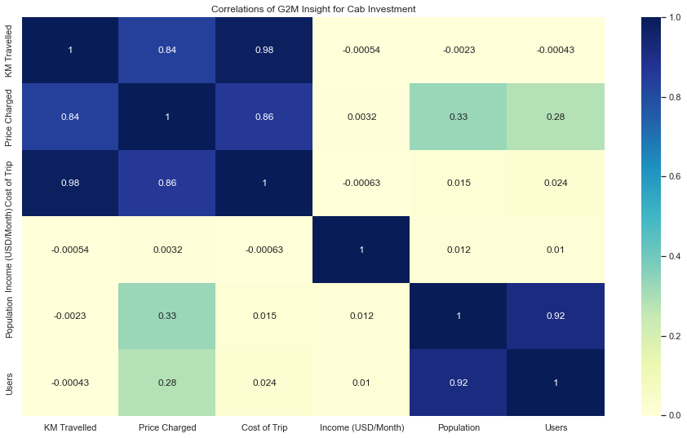
Features Correlation
There's a strong correlation between:
The Cost of the Price Charged and both KM Travelled and the Cost of the Trip.
the number of Users and Population.

Slide 5
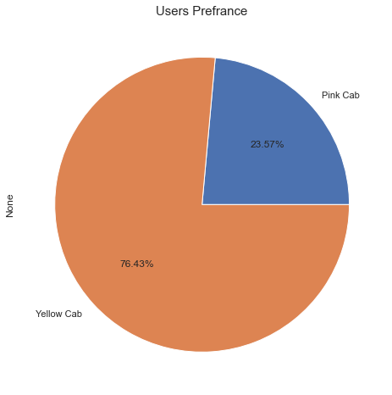
Users Preference
What company do users prefer to use more?
76.43% of the users prefer Yellow Cab over Pink Cab

Slide 6
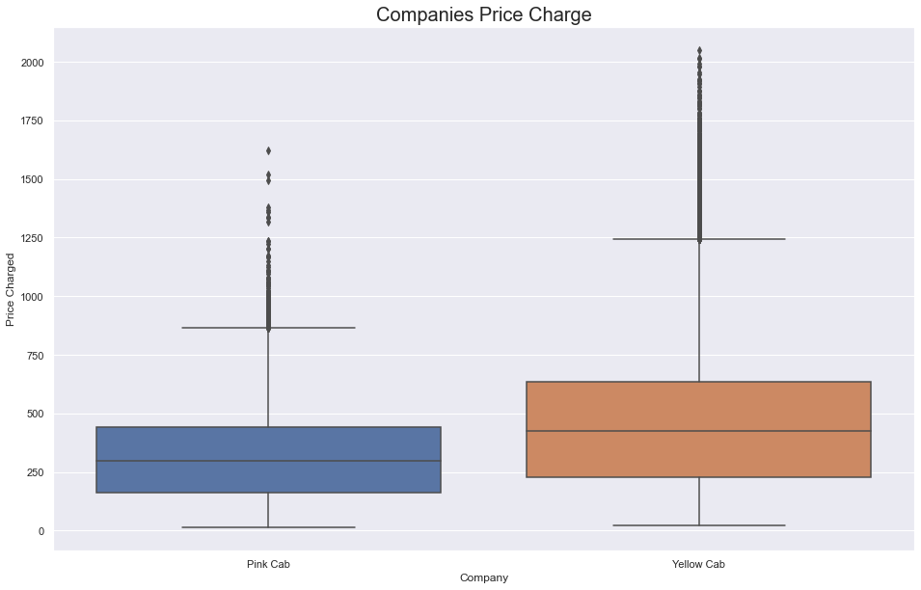
Price Charge
Which company charges more?
Yellow Cab charges an average of 458$ per ride
Pink Cab charges an average of 310$ per ride

Slide 7
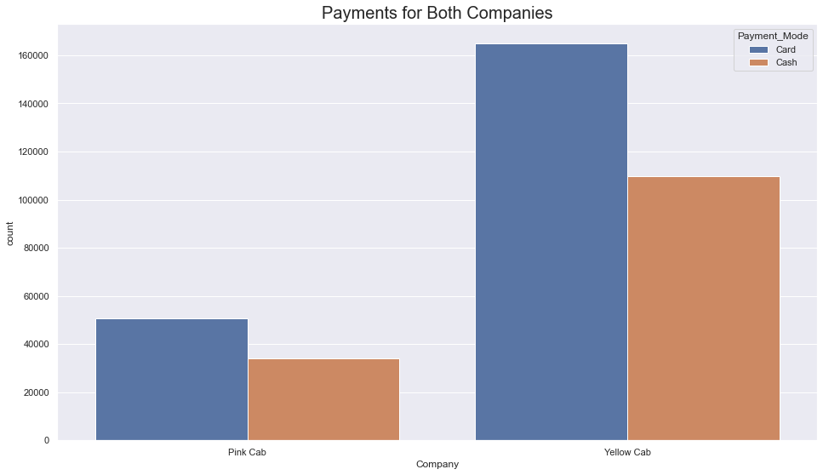
Payment Method
Which payment method is most used?
In both companies, users prefer to pay using cards over cash

Slide 8
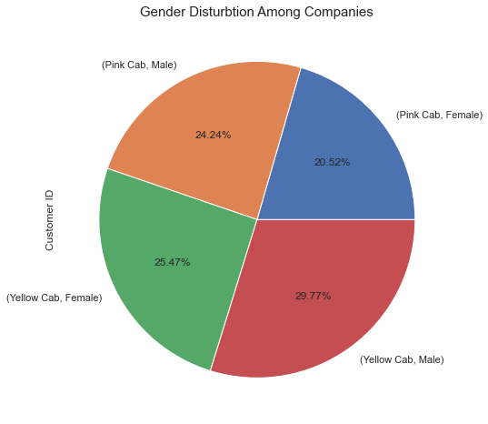
Gender Distribution
What is gender distribution among companies?
Males represent 54% of users, and 29.77% of Male prefer to ride Yellow Cab while Pink Cab scores the lowest Female users present with only 20.52%.

Slide 9
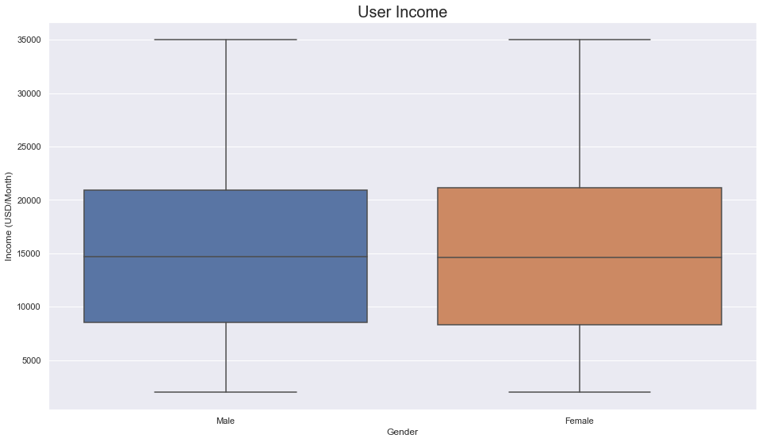
Gender Income
What is the average income based on gender
The average income for both genders is 15K$

Slide 10
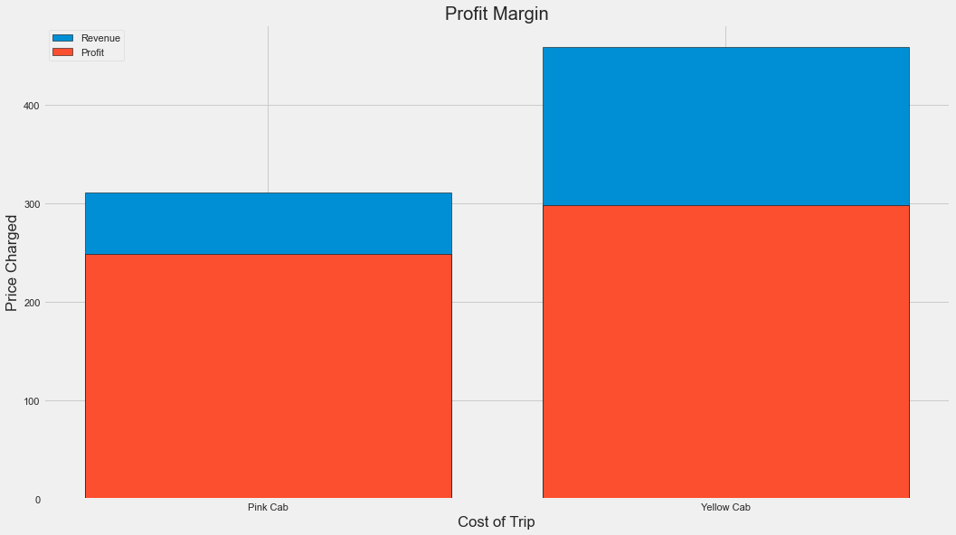
Profit Margin
Who has higher profit margin?
Yellow cab has a higher Profit Margin with average of 160$ compared to Pink cab

Slide 11
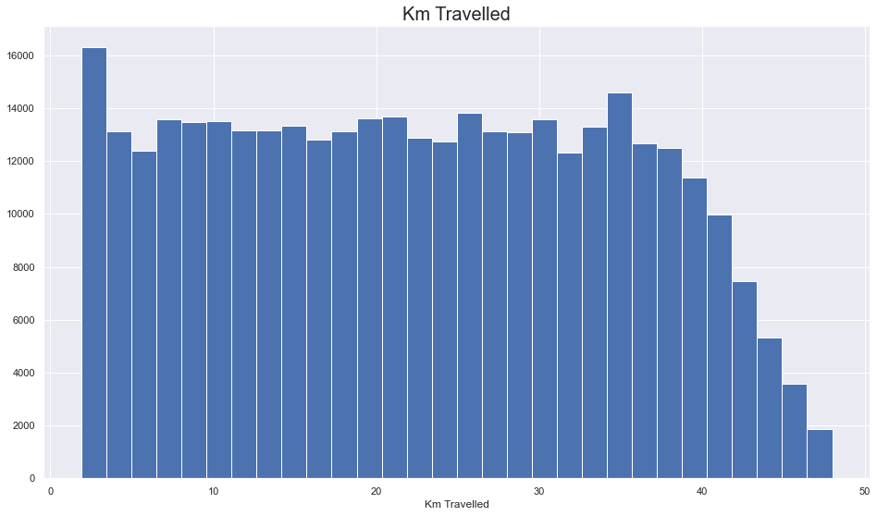
KM Distribution
What is the average profit rate?
Most rides take from 22 KM to 48 KM

Slide 12
Conclusion
Based on the analysis we conducted Investing in Yellow Cab is more profitable than investing in Pink Cab.
Yellow Cab has a higher profit margin.
Yellow Cab has a wide range of users from both genders.

Slide 13
Thank You

